Slide 1
DineTogether
Advit Bhullar

Slide 2
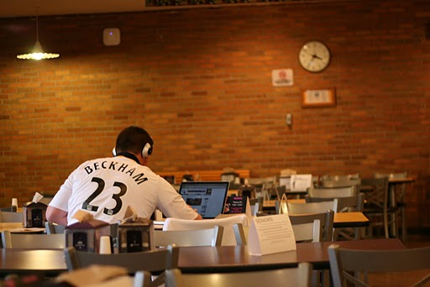
Problem Statement
Students especially freshmen find it difficult to interact with each other.
Most of the students sit alone in the dining court and do not approach others to sit with them because they are shy.
This application enables students to tell others that they are available, so that other students can approach without worrying about their privacy.
This can help students interact and connect with a lot of other students.

Slide 3
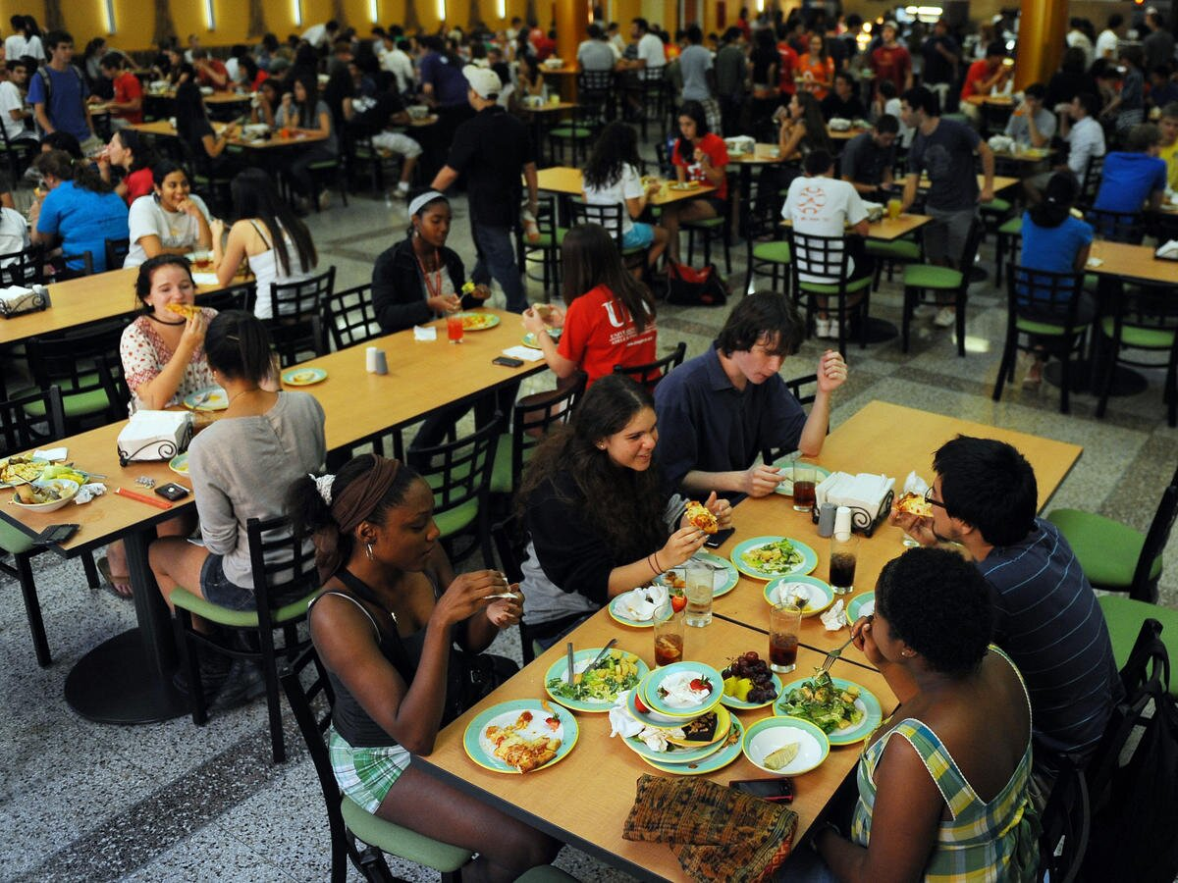
Our Solution
DineTogether
Server and Client based application which allows users to create account on the application.
Students can send messages to each other whenever they are in dining court and want to interact with others.
The application is 100 % based on GUIs.

Slide 4
Features
Students can login later too because the account details persist with the help of file input/output.
Students can send the messages in the chat room and can read others’ messages.
Use of Graphical User Interface in the application makes it very easy to interact with it.
Because of a heavy server and light client, the client works fast.
The data does not go away even in the case of complete shutdown because of File I/O.

Slide 5
FAQ
How do you handle multiple users on the same server?
How do you ensure that you’re GUI doesn’t freeze?
In the case of a server shutdown, how will you recover the data?

